Slide 1

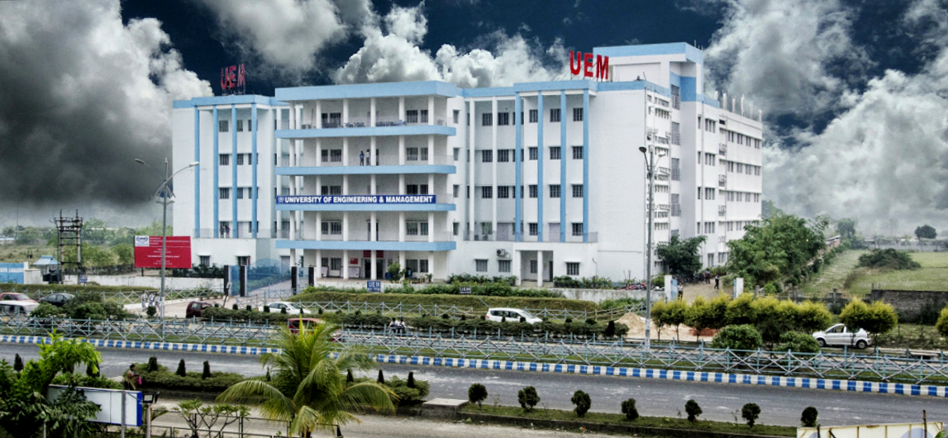
UNIVERSITY OF ENGINEERING & MANAGEMENT, KOLKATA
Course Name : Database Management System
Dr. Sandip Mandal
Dept. of CSE, UEM Kolkata
WhatsApp : +91-8449007365
Email : sandip.mandal@uem.edu.in

Slide 2
Module 3: Relational Algebra
 | UNIVERSITY OF ENGINEERING & MANAGEMENT, KOLKATA
2

Slide 3
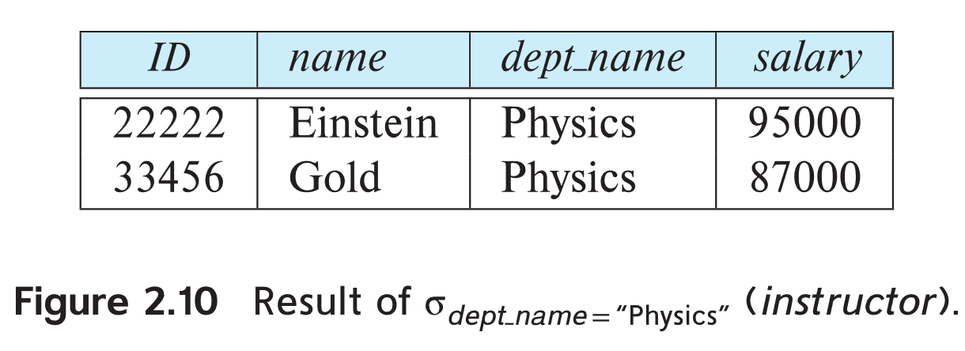
Select Operation
 | UNIVERSITY OF ENGINEERING & MANAGEMENT, KOLKATA
The select operation selects tuples that satisfy a given predicate.
Notation: σ _{p} (r)
p is called the selection predicate
Example: select those tuples of the instructor relation where the instructor is in the “Physics” department.
Query
σ _{dept_name=“Physics”} (instructor)
Result

Slide 4
Select Operation (Cont.)
 | UNIVERSITY OF ENGINEERING & MANAGEMENT, KOLKATA
We allow comparisons using
=, ≠, >, ≥. <. ≤
in the selection predicate.
We can combine several predicates into a larger predicate by using the connectives:
∧ (and), ∨ (or), ¬ (not)
Example: Find the instructors in Physics with a salary greater $90,000, we write:
σ _{dept_name=“Physics”} ∧ _{salary >} _{90,000} (instructor)
The select predicate may include comparisons between two attributes.
Example, find all departments whose name is the same as their building name:
σ _{dept_name=building} (department)

Slide 5
Project Operation
 | UNIVERSITY OF ENGINEERING & MANAGEMENT, KOLKATA
An unary operation that returns its argument relation, with certain attributes left out.
Notation:
∏ _{A1,A2,A3 ….Ak} (r)
where A₁, A₂, …, A_{k} are attribute names and r is a relation name.
The result is defined as the relation of k columns obtained by erasing the columns that are not listed
Duplicate rows removed from result, since relations are sets

Slide 6
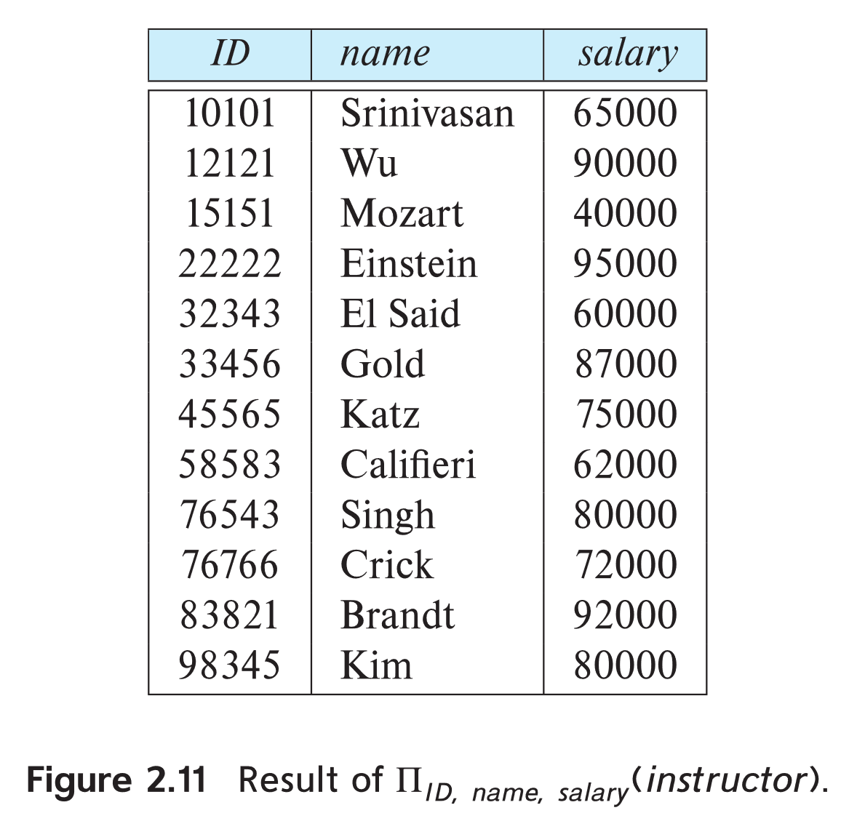
Project Operation Example
 | UNIVERSITY OF ENGINEERING & MANAGEMENT, KOLKATA
Example: eliminate the dept_name attribute of instructor
Query: ∏_{ID, name, salary} (instructor)
Result:

Slide 7
Composition of Relational Operations
 | UNIVERSITY OF ENGINEERING & MANAGEMENT, KOLKATA
The result of a relational-algebra operation is relation and therefore of relational-algebra operations can be composed together into a relational-algebra expression.
Consider the query -- Find the names of all instructors in the Physics department.
∏_{name}(σ _{dept_name} _{=“Physics”} (instructor))
Instead of giving the name of a relation as the argument of the projection operation, we give an expression that evaluates to a relation.

Slide 8
Cartesian-Product Operation
 | UNIVERSITY OF ENGINEERING & MANAGEMENT, KOLKATA
The Cartesian-product operation (denoted by X) allows us to combine information from any two relations.
Example: the Cartesian product of the relations instructor and teaches is written as:
instructor X teaches
We construct a tuple of the result out of each possible pair of tuples: one from the instructor relation and one from the teaches relation (see next slide)
Since the instructor ID appears in both relations we distinguish between these attribute by attaching to the attribute the name of the relation from which the attribute originally came.
instructor.ID
teaches.ID

Slide 9
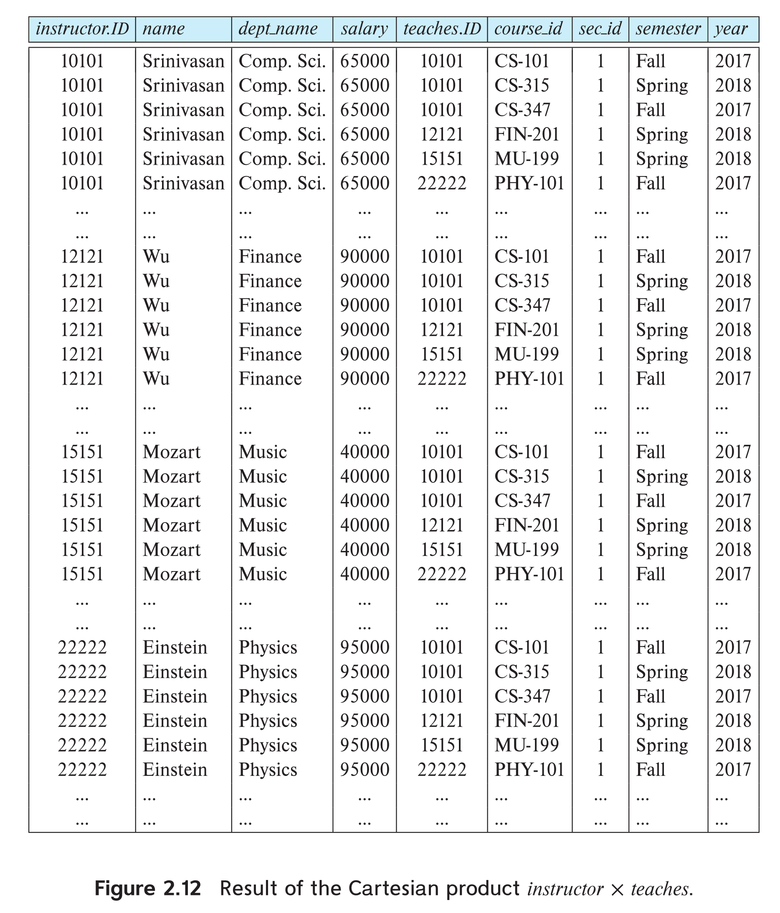
The instructor X teaches table
 | UNIVERSITY OF ENGINEERING & MANAGEMENT, KOLKATA

Slide 10
Join Operation
 | UNIVERSITY OF ENGINEERING & MANAGEMENT, KOLKATA
The Cartesian-Product
instructor X teaches
associates every tuple of instructor with every tuple of teaches.
Most of the resulting rows have information about instructors who did NOT teach a particular course.
To get only those tuples of “instructor X teaches “ that pertain to instructors and the courses that they taught, we write:
σ _{instructor.id = teaches.id} (instructor x teaches ))
We get only those tuples of “instructor X teaches” that pertain to instructors and the courses that they taught.
The result of this expression, shown in the next slide

Slide 11
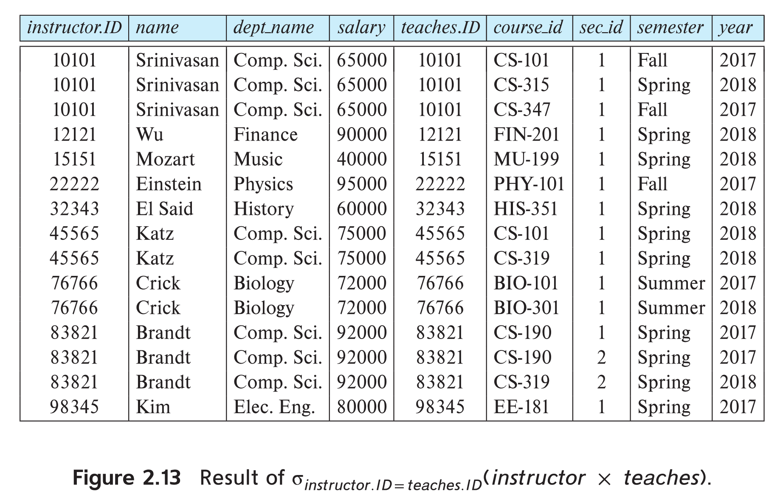
Join Operation (Cont.)
 | UNIVERSITY OF ENGINEERING & MANAGEMENT, KOLKATA
The table corresponding to:
σ _{instructor.id = teaches.id} (instructor x teaches))

Slide 12
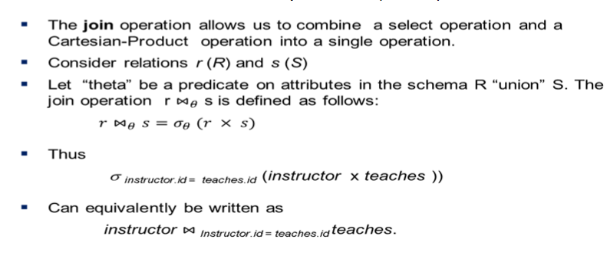
Join Operation (Cont.)
 | UNIVERSITY OF ENGINEERING & MANAGEMENT, KOLKATA

Slide 13
Banking Example
 | UNIVERSITY OF ENGINEERING & MANAGEMENT, KOLKATA
branch (branch-name, branch-city, assets)
customer (customer-name, customer-street, customer-only)
account (account-number, branch-name, balance)
loan (loan-number, branch-name, amount)
depositor (customer-name, account-number)
borrower (customer-name, loan-number)

Slide 14
Banking Example
 | UNIVERSITY OF ENGINEERING & MANAGEMENT, KOLKATA
Find all loans of over $1200
σ_{amount > 1200} (loan)
Find the loan number for each loan of an amount greater than $1200
∏_{loan-number} (σ_{amount > 1200} (loan))

Slide 15
Banking Example
 | UNIVERSITY OF ENGINEERING & MANAGEMENT, KOLKATA
Find the names of all customers who have a loan, an account, or both, from the bank
∏_{customer-name} (borrower) ∪ ∏_{customer-name} (depositor)
Find the names of all customers who have a loan and an account at bank.
∏_{customer-name} (borrower) ∩ ∏_{customer-name} (depositor)

Slide 16
Banking Example
 | UNIVERSITY OF ENGINEERING & MANAGEMENT, KOLKATA
Find the names of all customers who have a loan at the Perryridge branch.
∏_{customer-name} (σ_{branch-name=“Perryridge”}
(σborrower.loan-number = loan.loan-number(borrower x loan)))
Find the names of all customers who have a loan at the Perryridge branch but do not have an account at any branch of the bank.
∏_{customer-name} (σ_{branch-name = “Perryridge”}
(σborrower.loan-number = loan.loan-number(borrower x loan))) – ∏_{customer-name}(depositor)

Slide 17
Banking Example
 | UNIVERSITY OF ENGINEERING & MANAGEMENT, KOLKATA
Find the names of all customers who have a loan at the Perryridge branch.
Query 1 ∏_{customer-name}(σ_{branch-name = “Perryridge”}
(σborrower.loan-number = loan.loan-number(borrower x loan)))
− Query 2
∏_{customer-name}(σloan.loan-number = borrower.loan-number( (σ_{branch-name = “Perryridge”}(loan)) x borrower) )

Slide 18
Banking Example
 | UNIVERSITY OF ENGINEERING & MANAGEMENT, KOLKATA
Find the largest account balance
Rename account relation as d
The query is:
∏_{balance}(account) - ∏_{account.balance}
(σ_{account.balance < d.balance} (account x r_{d} (account)))

Slide 19

 | UNIVERSITY OF ENGINEERING & MANAGEMENT, KOLKATA
Thank You
19

